Slide 1
Power BI Dashboard Summary
By
Aasmi Marwal

Slide 2
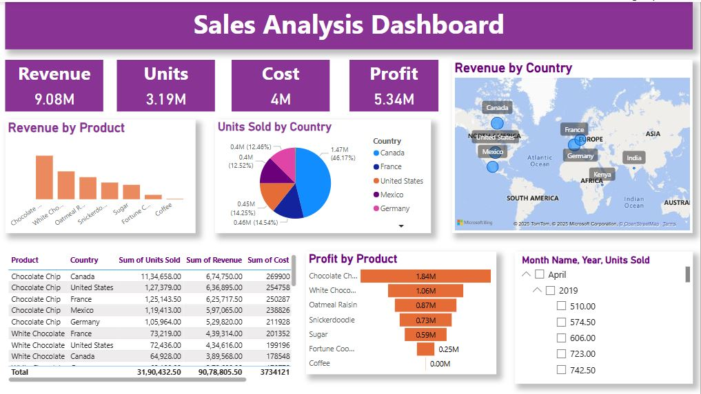
Dashboard Overview

Slide 3

Cards
I used cards to represent quick access to overall estimate of data.

Slide 4
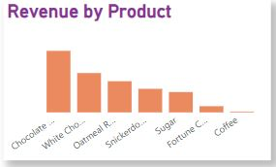
Bar Chart
This column bar chart was used to represent the revenue as per the products.

Slide 5
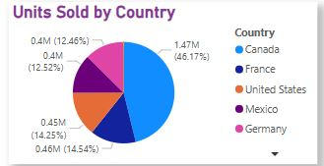
Pie Chart
I used pie chart to represent the units of products sold by different countries.

Slide 6
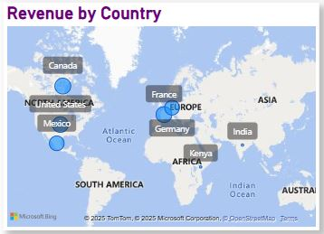
Map
I used the map feature to represent the revenue earned by different countries in the world.

Slide 7
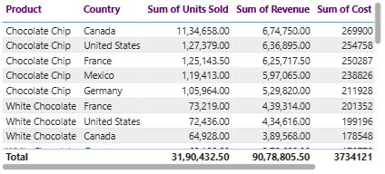
Table
I used the table feature to represent the data regarding product, country, sum of units sold, sum of revenue, sum of cost and profit.

Slide 8
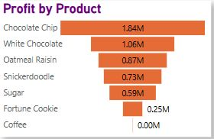
Funnel
I used the funnel to indicate the profit earned by every product. Ranging from highest to lowest.

Slide 9
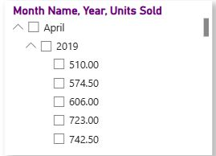
Slicer
I used slicer to view the data for the units sold in the particular month and the year.

